Slide 1

Helping Hand
Garðar Benediktsson, Gabrielle Stoney, Harrison Dinius, Jason Lee Hansen, Elizabeth Jackson

Slide 2
Vision for Product
First began the project during Suicide Prevention month
COVID was causing many people to feel or be isolated
Wanted to help people feel connected
Application would use social media to track communication frequency (both increases and decreases)
Vision Statement: To track message/like/comment data from Twitter and Facebook with friends by obtaining contact information on a personal device in pursuit of maintaining the user's mental health.

Slide 3
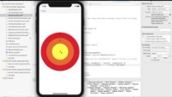
Demo Video
https://www.youtube.com/watch?v=f-V-SSO0hYU

Slide 4
Documentation
SRS
Created for helping those both in the team and outside of it
All requirements of what the app can do
SDS
Explains and shows framework of the app
Could be used to further build the application (should any future team decide to work on it)
Test Plan
Every requirement has a test for determining functionality

Slide 5
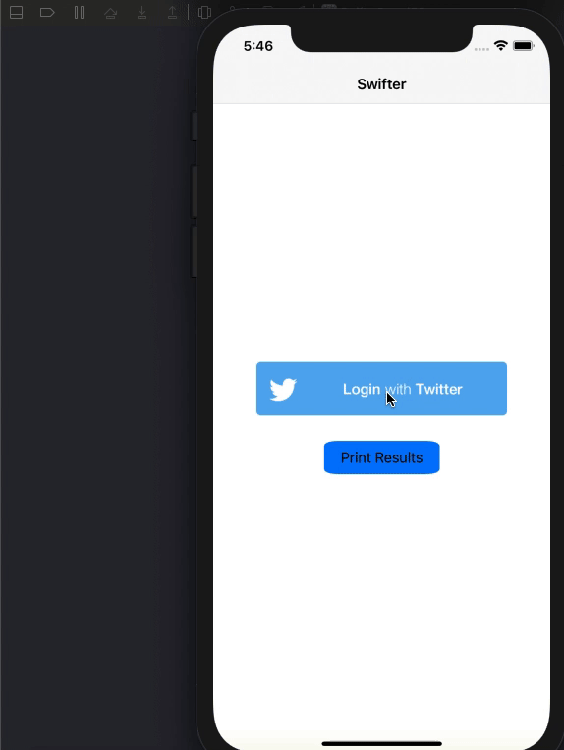
Data Gathered for Trust Calculations
Swifter – Twitter API
Passive Data Pulling
Favorites: API Call to get most recent favorited posts by the app user
Display name of the poster provided by call
Time in date format of post is provided by call
Messages: API Call to get message data from the last 30 days
One extra call to fetch the app users userID to remove it
UserIDs provided from call requires another call to fetch display names
Unix time timestamps provided by call is converted to match favorites
Facebook JSON Parsing
Download a copy of your data directly through Facebook
This includes comment data and likes data
Upload to the application (through XCode for the simulation)
Pulls the name and timestamp from each interaction
Does not record/save any other user data
All parsed data is sent to the algorithm for computing trust

Slide 6
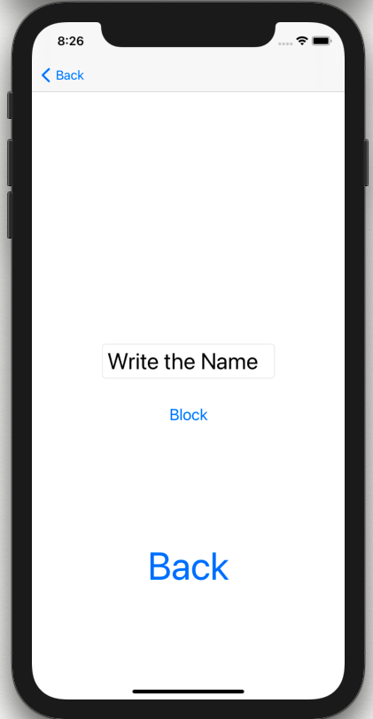

Contact Management
Contacts are pulled locally from the phone
Stored in a Swift dictionary
Serve as the master contact list
All parsed data is synched with the dictionary
Requires matching names
Non-matching users in the data are not saved
Block contacts by entering their name
Can block multiple contacts
Again, the names must be identical

Slide 7
Trust Value Calculations
Computational Modeling of Trust and Social Relationships
Building relationships
Relationship decay
Weight on different social media
Used to gather who interacted the most
What that would mean to the user
Accounted for celebrities/meme pages etc.

Slide 8
Retrospective and Looking Back
Sprint Review
Well done:
Great Communication
Delivered a great product
Improvements
Don’t put everything of until the end
Time management
Don’t underestimate the complexity of things
Our takeaways
Enjoyable experience
Learned a new programming language
Proud of our product

Slide 9

Questions?

